Slide 1
Lecture 10
Requirements Modeling:
  Structural Modeling
    Class Diagram
BSCS (Software Engineering-I) SZABIST-Islamabad

Slide 2
What is Entity and Relationship?
Entity is a real-world object distinguishable or unique from other objects. It can be thought of as a noun like student, employee etc. It is normally represented by a rectangle shape.
Relation is a way of relating one entity to another. It is normally represented by a diamond shape.
Example: A connection is established between person and car because the two objects are related.
A person owns a car
  One-to-One
  One-to-Many
  Many-to-Many
BSCS (Software Engineering-I) SZABIST-Islamabad

Slide 3
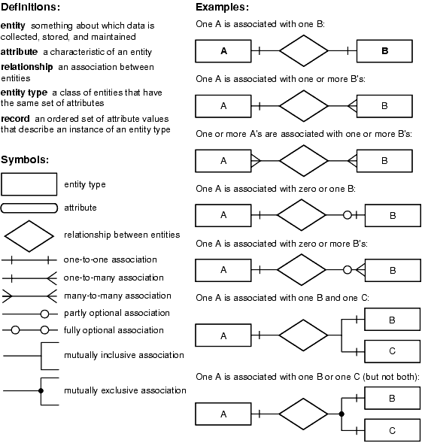
Relationship
BSCS (Software Engineering-I) SZABIST-Islamabad

Slide 4
2. Structural Model
Structural Models of software display the organization of a system in terms of the components that make up that system and their relationships.
Structural models may be static models, which show the structure of the system design, or dynamic models, which show the organization of the system when executing.
We create structural models of a system when we are discussing and designing the system architecture.
BSCS (Software Engineering-I) SZABIST-Islamabad

Slide 5
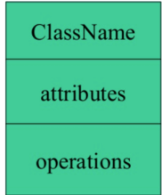
Class Diagram
Class diagram is UML structure diagram which shows structure of the designed system at the level of classes and interfaces, shows their features, constraints and relationships associations, generalizations, dependencies, etc.
Class diagrams clearly map out the structure of a particular system by modeling its classes, attributes, operations, and relationships between objects.
BSCS (Software Engineering-I) SZABIST-Islamabad

Slide 6
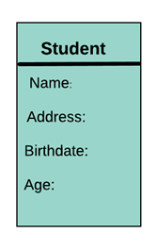
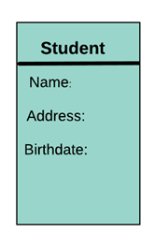
Attributes
Attributes: An attribute is named property of a class which describes the object being modeled. In the class diagram, this component is placed just below the name-compartment.
A derived attribute is computed from other attributes. For example, an age of the student can be easily computed from his/her birth date.
Syntax: Name: type
BSCS (Software Engineering-I) SZABIST-Islamabad

Slide 7
Operations
An operation is a method or function that can be performed by an instance of a class or interface.
Example: get, Set, Update etc
Operations can be divided into four broad categories:
  operations that manipulate data in some way (e.g., adding, deleting, reformatting, selecting)
  operations that perform a computation
  operations that inquire about the state of an object
  operations that monitor an object for the occurrence of a controlling event.
Syntax Name (class name)
BSCS (Software Engineering-I) SZABIST-Islamabad

Slide 8
Type of Relationships in Class Diagrams
Relation
Generalization
Association
Dependency
Binary Association
N-ary Association
Aggregation
BSCS (Software Engineering-I) SZABIST-Islamabad

Slide 9
Relationships in Class Diagrams
Classes are interrelated to each other in specific ways. In particular, relationships in class diagrams include different types of logical connections. The following are such types of logical connections that are possible in UML:
Association
Directed Association
Reflexive Association
Multiplicity
Dependency
Aggregation
Composition
Inheritance/Generalization
Realization
BSCS (Software Engineering-I) SZABIST-Islamabad

Slide 10
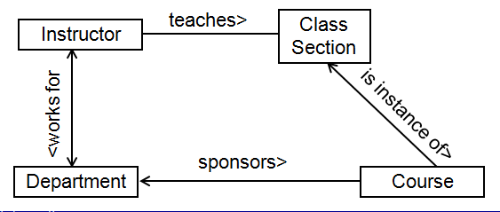
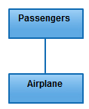
Association
Association is a broad term that encompasses just about any logical connection or relationship between classes.
  The name should include an arrow indicating the direction in which the name should be read.
For example, passenger and airline may be linked as above:
The navigation of associations can be
  uni-directional
  bi-directional
  unspecified
BSCS (Software Engineering-I) SZABIST-Islamabad

Slide 11
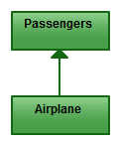
Directed Association
Directed Association refers to a directional relationship represented by a line with an arrowhead. The arrowhead depicts a container-contained directional flow.
BSCS (Software Engineering-I) SZABIST-Islamabad

Slide 12

Reflexive Association
This occurs when a class may have multiple functions or responsibilities.
For example, a staff member working in an airport may be a pilot, aviation engineer, a ticket dispatcher, a guard, or a maintenance crew member. If the maintenance crew member is managed by the aviation engineer there could be a managed by relationship in two instances of the same class.
BSCS (Software Engineering-I) SZABIST-Islamabad

Slide 13
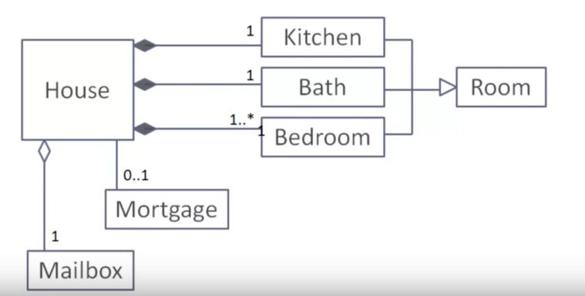
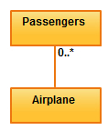
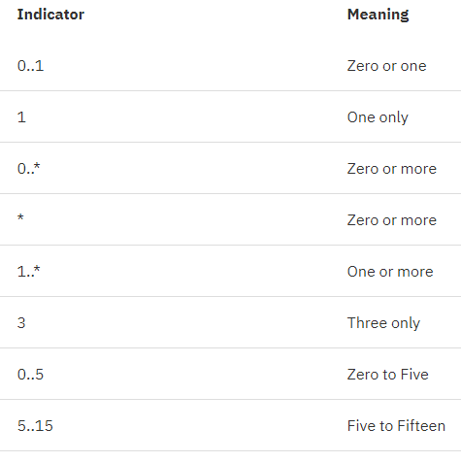

Multiplicity
Multiplicity is the active logical association when the cardinality of a class in relation to another is being depicted.
For example, one fleet(ownership/organization) may include multiple airplanes, while one commercial airplane may contain zero to many passengers. The notation 0..* in the diagram means “zero to many”.
BSCS (Software Engineering-I) SZABIST-Islamabad

Slide 14
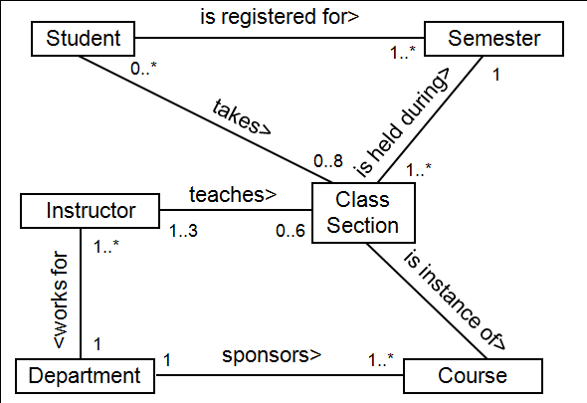
Multiplicity Example
BSCS (Software Engineering-I) SZABIST-Islamabad

Slide 15
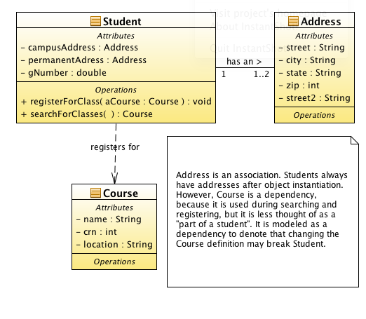
Dependency
It says that one modeling component “uses” another.
If the later changes then, the former may have to change as well
BSCS (Software Engineering-I) SZABIST-Islamabad

Slide 16
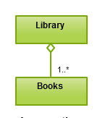
Aggregation
Aggregation refers to the formation of a particular class as a result of one class being aggregated or built as a collection.
For example, the class “library” is made up of one or more books, among other materials. In aggregation, the contained classes are not strongly dependent on the lifecycle of the container. In the same example, books will remain so even when the library is dissolved. To show aggregation in a diagram, draw a line from the parent class to the child class with a diamond shape near the parent class.
Crust
1
1
Sauce Serving
1
1
Pizza
1
Order
Cheese Serving
1..3
1
1
Topping Serving
0..9
4..*
Slice
BSCS (Software Engineering-I) SZABIST-Islamabad

Slide 17
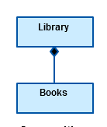
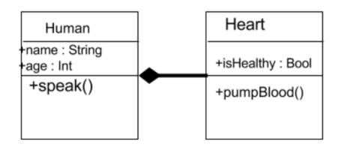
Composition
The composition relationship is very similar to the aggregation relationship. with the only difference being its key purpose of emphasizing the dependence of the contained class to the life cycle of the container class. That is, the contained class will be obliterated when the container class is destroyed.
For example, a shoulder bag’s side pocket will also cease to exist once the shoulder bag is destroyed.
To show a composition relationship in a UML diagram, use a directional line connecting the two classes, with a filled diamond shape adjacent to the container class and the directional arrow to the contained class.
Room
Building
BSCS (Software Engineering-I) SZABIST-Islamabad

Slide 18
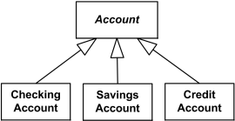
Inheritance / Generalization
Inheritance/ Generalization refers to a type of relationship wherein one associated class is a child of another by virtue of assuming the same functionalities of the parent class. In other words, the child class is a specific type of the parent class. To show inheritance in a UML diagram, a solid line from the child class to the parent class is drawn using an unfilled arrowhead.
BSCS (Software Engineering-I) SZABIST-Islamabad

Slide 19
Inheritance / Generalization
You can use the following UML keywords as constraints:
complete – signify that in this generalization association are specified all subclasses and the superclass cannot have another subclasses.
disjoint – signify that subclasses cannot contain the objects that are the instances of two or more classes at the same time.
incomplete – signify that on the diagram are not specified all the subclasses
overlapping – signify that some instances of subclasses can belong to two or more classes at the same time.
BSCS (Software Engineering-I) SZABIST-Islamabad

Slide 20
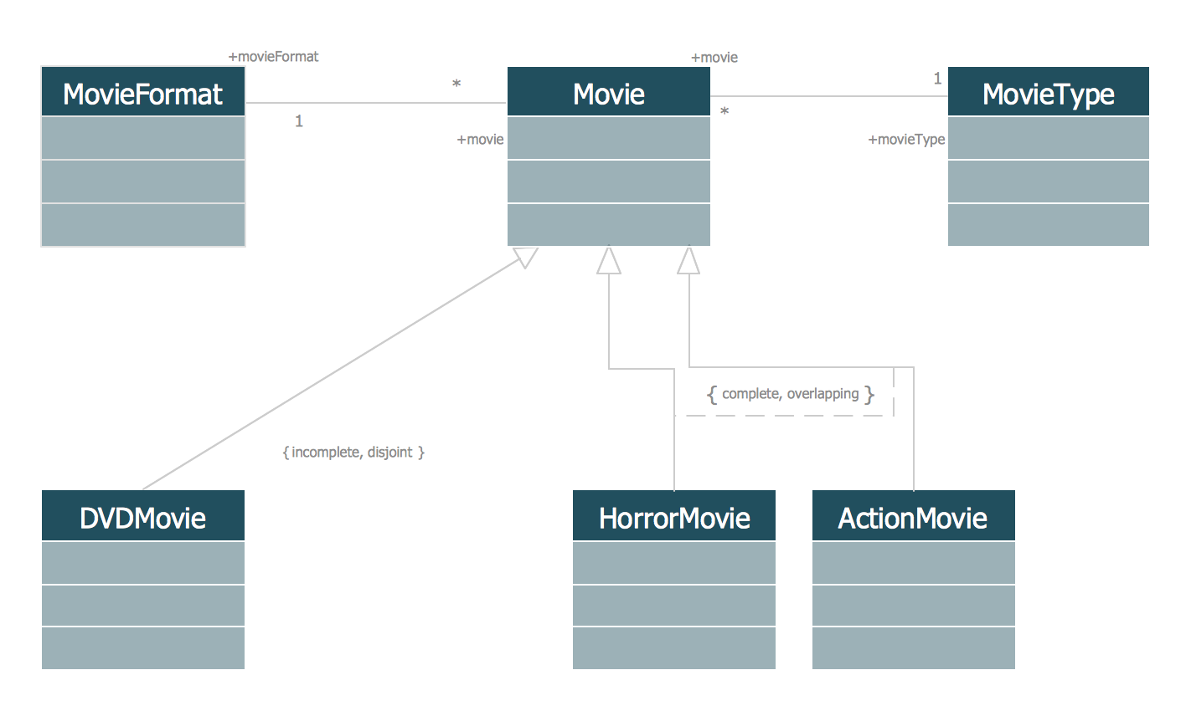
Inheritance / Generalization
BSCS (Software Engineering-I) SZABIST-Islamabad

Slide 21
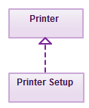
Realization
Realization denotes the implementation of the functionality defined in one class by another class. To show the relationship in UML, a broken line with an unfilled solid arrowhead is drawn from the class that defines the functionality of the class that implements the function.
Example, the printing preferences that are set using the printer setup interface are being implemented by the printer.
BSCS (Software Engineering-I) SZABIST-Islamabad

Slide 22
Class Diagram
Class diagrams are one of the most useful types of diagrams in UML as they clearly map out the structure of a particular system by modeling its classes, attributes, operations, and relationships between objects. With our UML diagramming software, creating these diagrams is not as overwhelming as it might appear. This guide will show you how to understand, plan, and create your own class diagrams.
Class diagram for a hotel management system
A class diagram can show the relationships between each object in a hotel management system, including guest information, staff responsibilities, and room occupancy. The example below provides a useful overview of the hotel management system. Get started on a class diagram by clicking the template below.
BSCS (Software Engineering-I) SZABIST-Islamabad

Slide 23
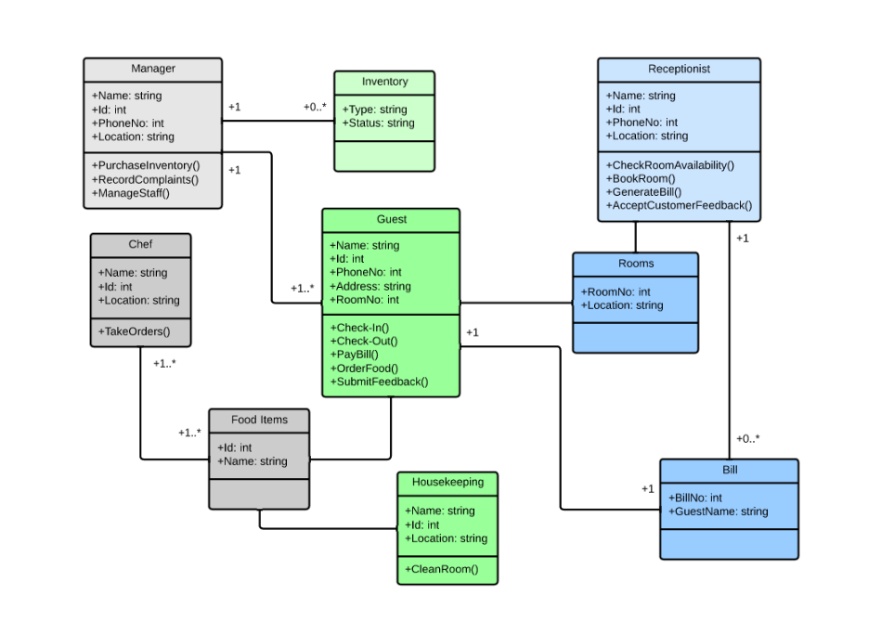
Class Diagram
BSCS (Software Engineering-I) SZABIST-Islamabad

Slide 24
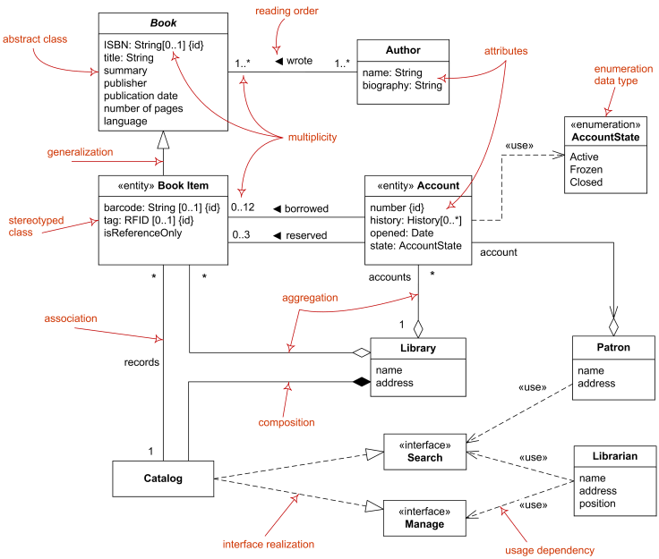
A class diagram
BSCS (Software Engineering-I) SZABIST-Islamabad

Slide 25
A class diagram
Create a class diagram of school management system.
Admin
Teacher
Student
Class
Division
Subject
Exams
BSCS (Software Engineering-I) SZABIST-Islamabad

Slide 26
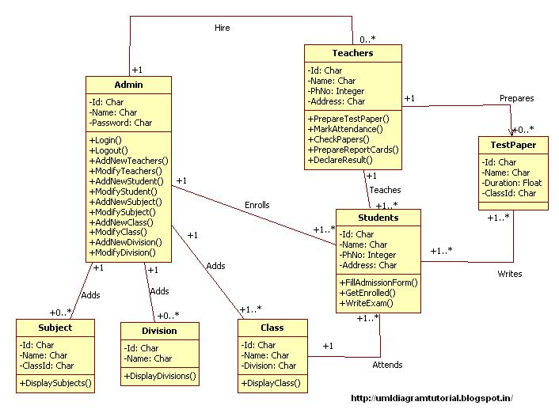
A class diagram
BSCS (Software Engineering-I) SZABIST-Islamabad

Slide 27
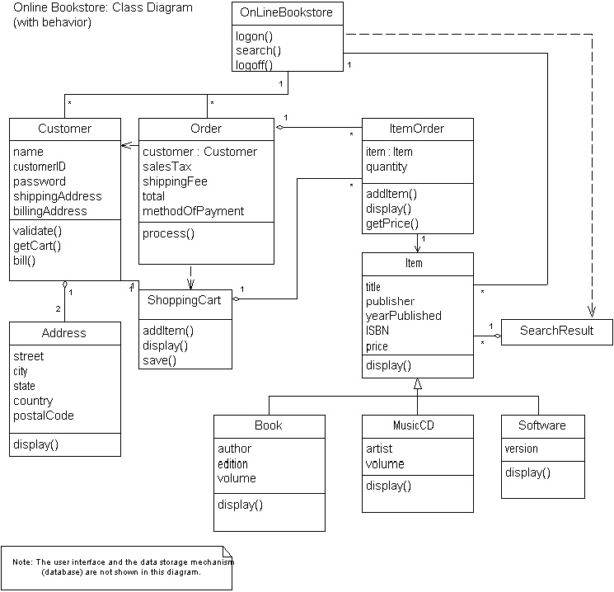
BSCS (Software Engineering-I) SZABIST-Islamabad

